Slide 1

Project Title
Supermart Profit Prediction & Retail Business Analytics System

Slide 2

Business Problem
Retail businesses face challenges in predicting profit due to fluctuating sales, discount strategies, seasonal demand, and product-level variations. Business teams need a reliable system to analyze historical performance and predict future profitability before making pricing or promotional decisions.

Slide 3
Project Objective
The objectives of this project were:
To analyze historical supermarket sales data
To understand the relationship between sales, discounts, and profit
To build a machine learning model for profit prediction
To deploy an interactive application for real-time businessdecision support
To demonstrate the use of Excel, SQL, Python, and Machine Learning in a single end-to-end project

Slide 4
Dataset Overview
The dataset contains historical grocery sales transactions with attributes such as:
Order details (Order ID, Customer Name)
Product information (Category, Sub-category)
Location details (City, Region, State)
Financial metrics (Sales, Discount, Profit)

Slide 5
TOOLS & TECHNOLOGIES USED
Excel – Initial data understanding & validation
SQL – Structured querying & business-level analysis
Python – Data cleaning, EDA, feature engineering
Machine Learning (Scikit-learn) – Model development
Streamlit – Model deployment & dashboard creation

Slide 6
Step 1: Excel Analysis (WHY & HOW)
Why Excel was used
Excel was used as the first-level analysis tool to quickly understand the data before moving to advanced tools.
What was done in Excel
Reviewed raw data structure and column meanings
Checked for missing values and incorrect data types
Identified outliers in Sales, Discount, and Profit
Created basic pivot tables:
Category-wise sales and profit
Region-wise performance
Used charts to visually understand:
Sales vs Profit trends
Discount impact on profit
Outcome: Excel helped validate data quality and provided initial business insights that guided further analysis in SQL and Python.

Slide 7
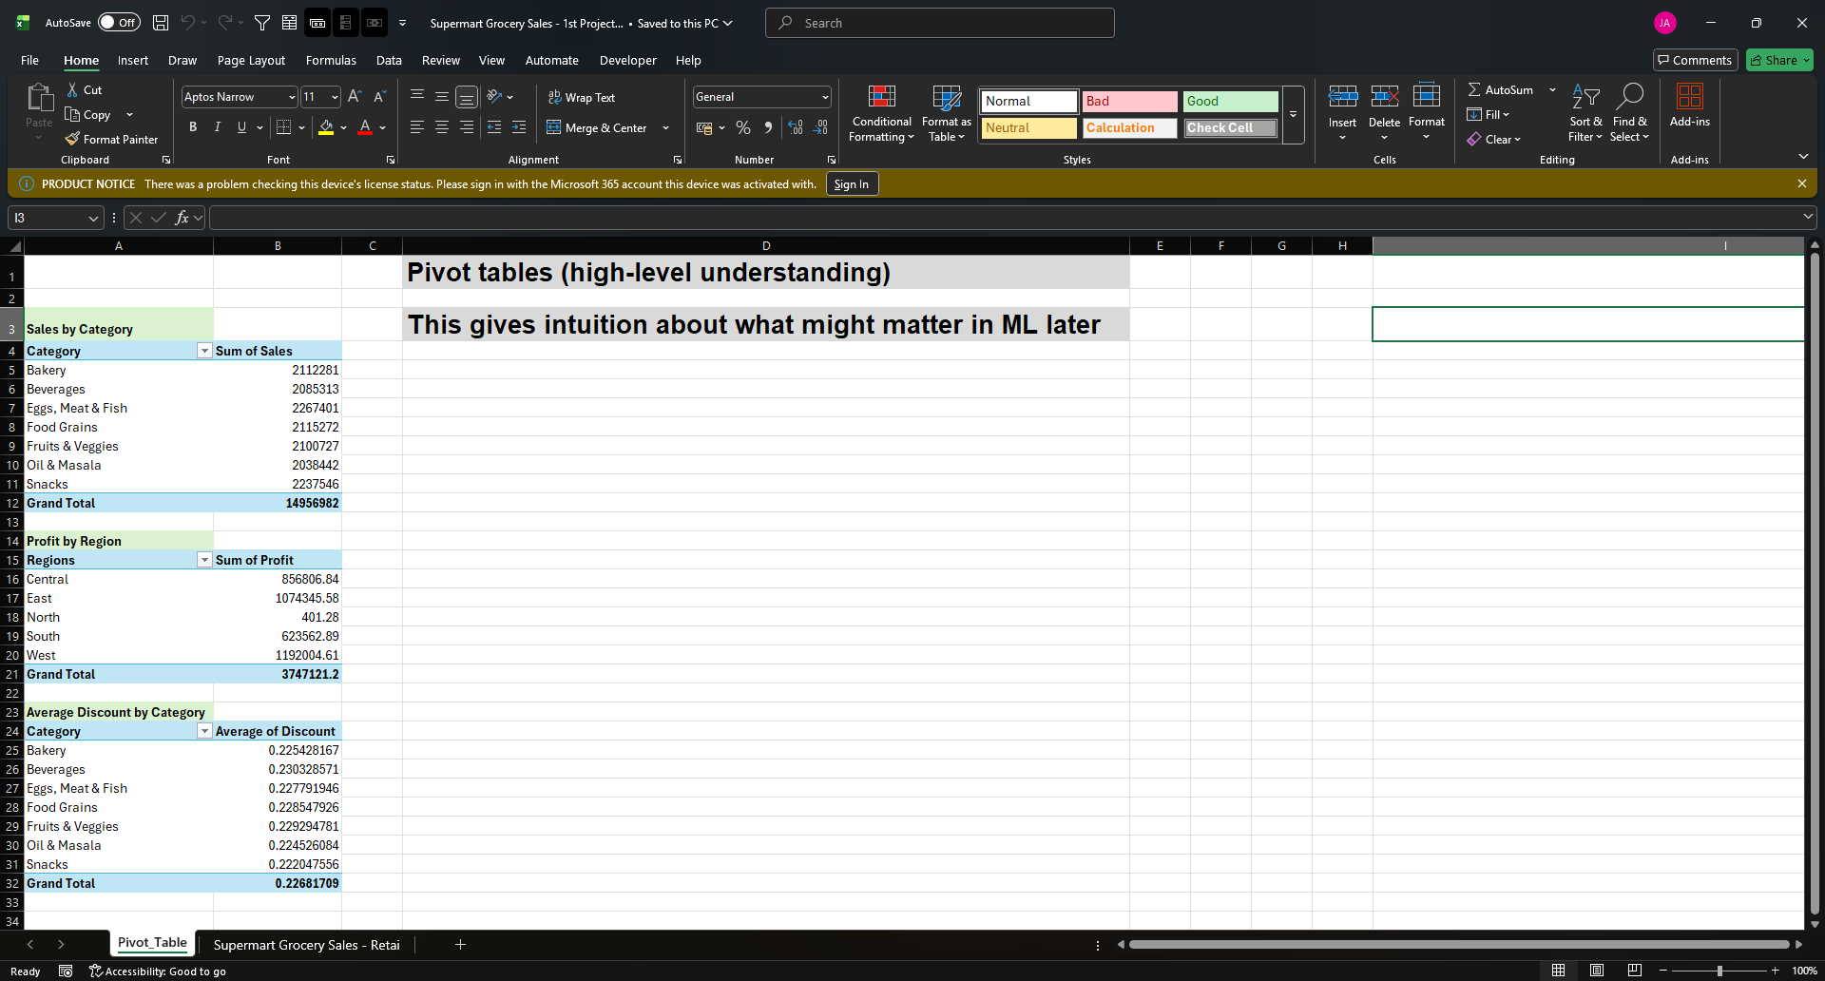

Slide 8
Step 2: SQL Analysis (WHY & HOW)
Why SQL was used
SQL was used to perform structured, business-driven analysis similar to how data is analyzed in real organizations using databases.
What was done using SQL
Queried total sales and profit by:
Category
Sub-category
Region
Identified top-performing and low-performing products
Analyzed discount impact using grouped aggregations
Validated business KPIs such as:
Average discount per region
Profit contribution by category
Example business questions answered via SQL:
Which category generates the highest profit?
Which region is most sensitive to discounts?
How does profit vary across different product segments?
Outcome: SQL helped transform raw data into business-ready insights and ensured the analysis aligned with real-world reporting practices.

Slide 9
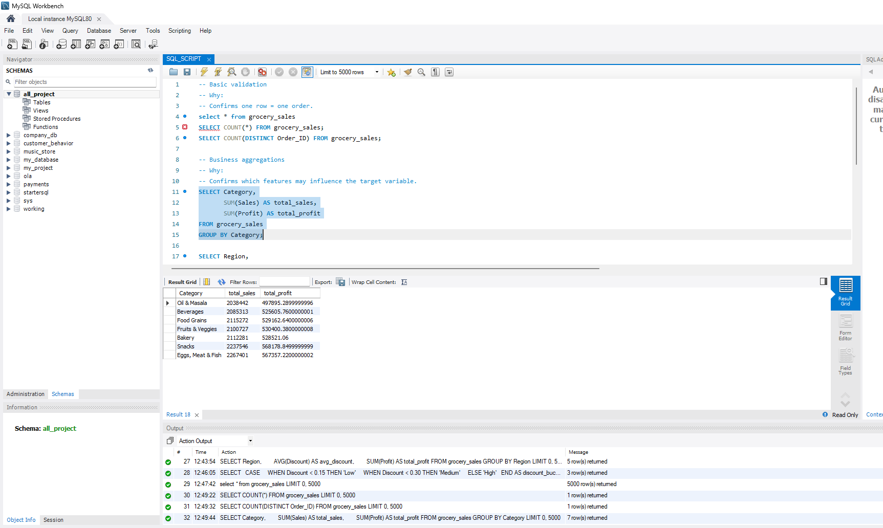
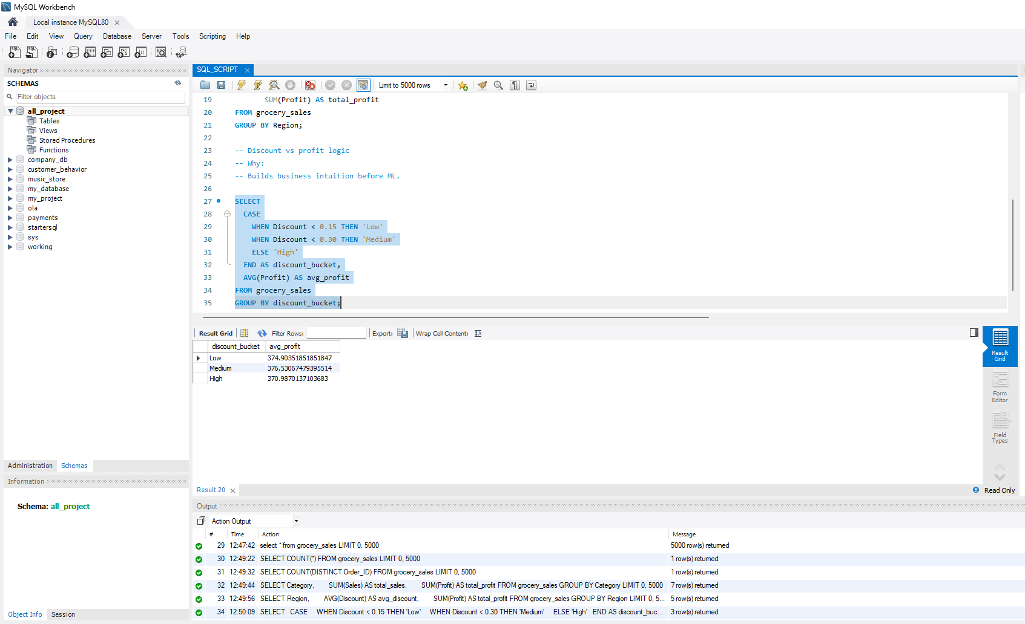
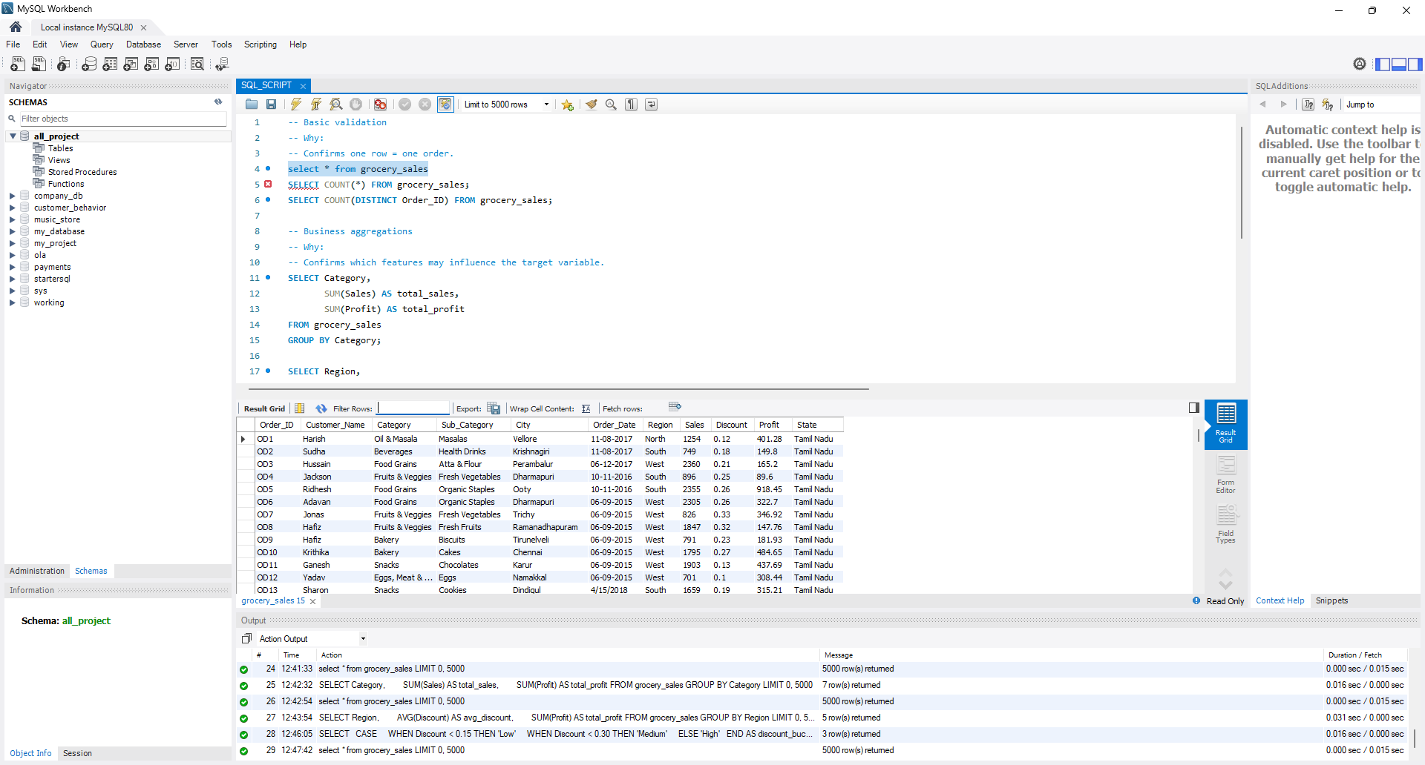
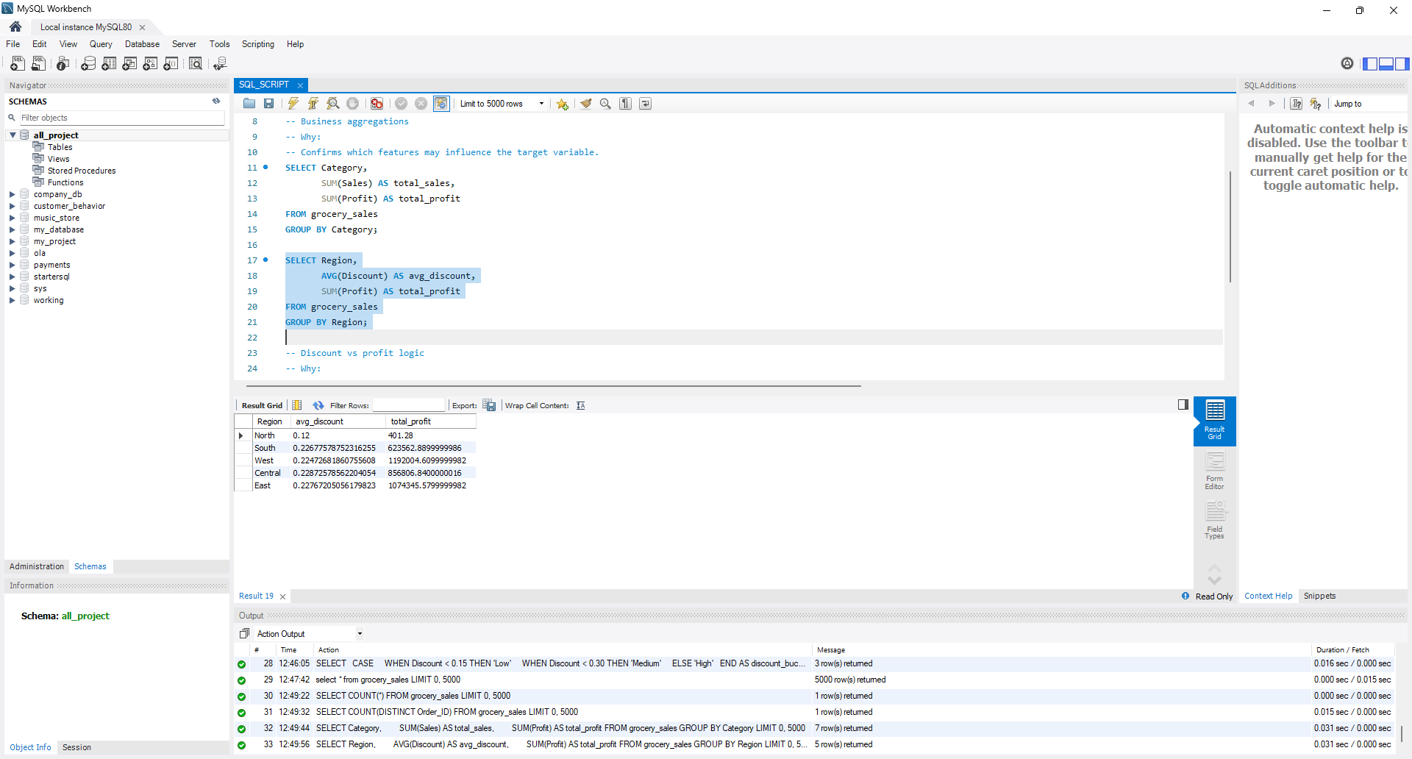
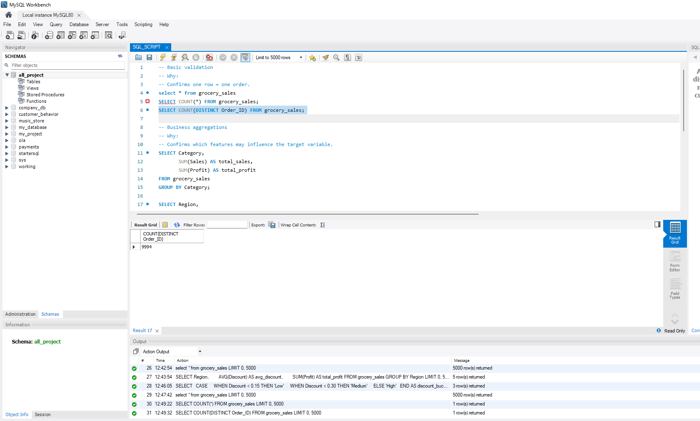
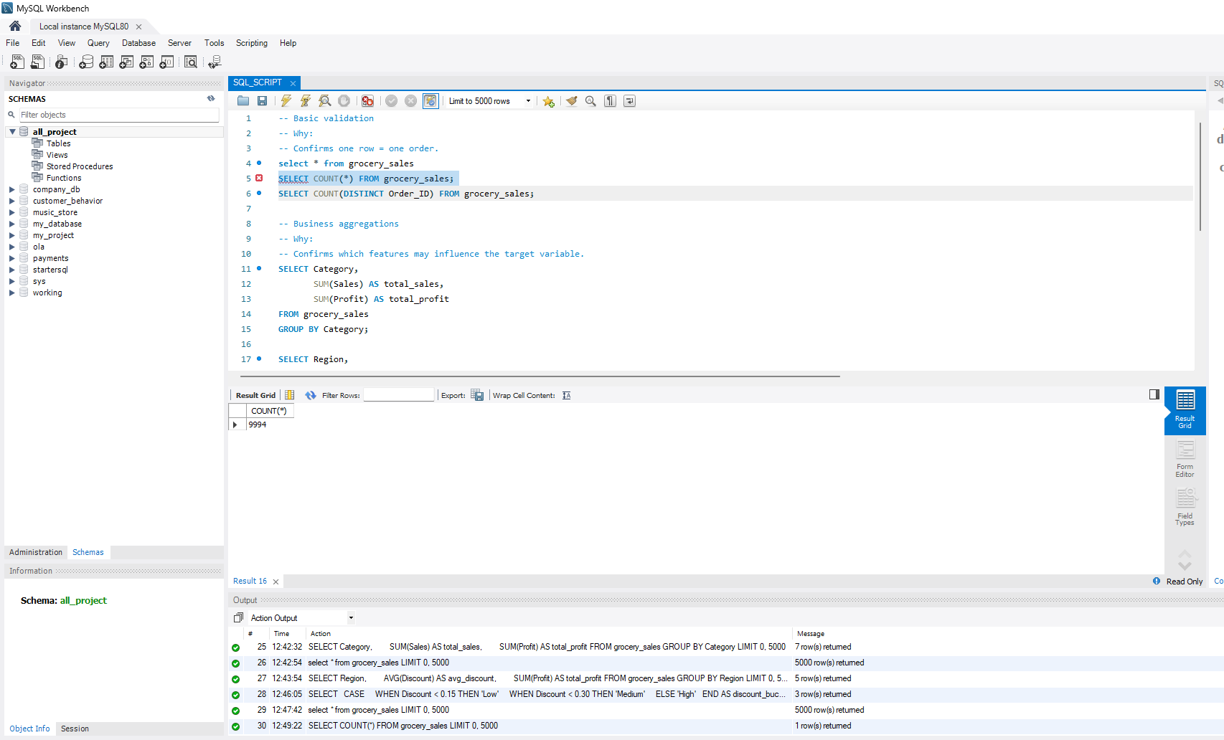
SQL QUERIES & ANSWERS

Slide 10
Step 3: Data Cleaning & Preprocessing (Python)
Python was used for deeper data preparation:
Cleaned and standardized column names
Converted numerical and date fields to proper formats
Removed irrelevant columns for modeling
Handled encoding of categorical variables
Prepared a clean dataset suitable for machine learning

Slide 11
Step 4: Exploratory Data Analysis (EDA)
EDA was performed using Python libraries:
Analyzed distributions of sales, profit, and discount
Studied relationships such as:
Discount vs Profit
Category vs Profit
Identified seasonal patterns using year and month
This step confirmed many insights initially observed in Excel and SQL.

Slide 12
Step 5: Feature Engineering
Additional features were created to enhance model learning:
Year, Month, Quarter
Weekend indicator
One-hot encoding for categorical variables
Numeric-only feature selection for ML compatibility

Slide 13
Step 6: Machine Learning Modeling
Baseline Model: Linear Regression
Used to establish a baseline performance
Provided interpretability of linear relationships
Advanced Model: Random Forest Regressor
Captured non-linear patterns
Improved handling of complex feature interactions
Provided better business-level insights
Models were evaluated using:
Mean Absolute Error (MAE)
R² Score

Slide 14
Step 7: Model Deployment using Streamlit
The trained Random Forest model was deployed using Streamlit Cloud:
Users can input order details
Real-time profit predictions are generated
Business warnings and insights are displayed
The app converts ML output into actionable insights
This step transformed the analysis into a production-style business application.

Slide 15
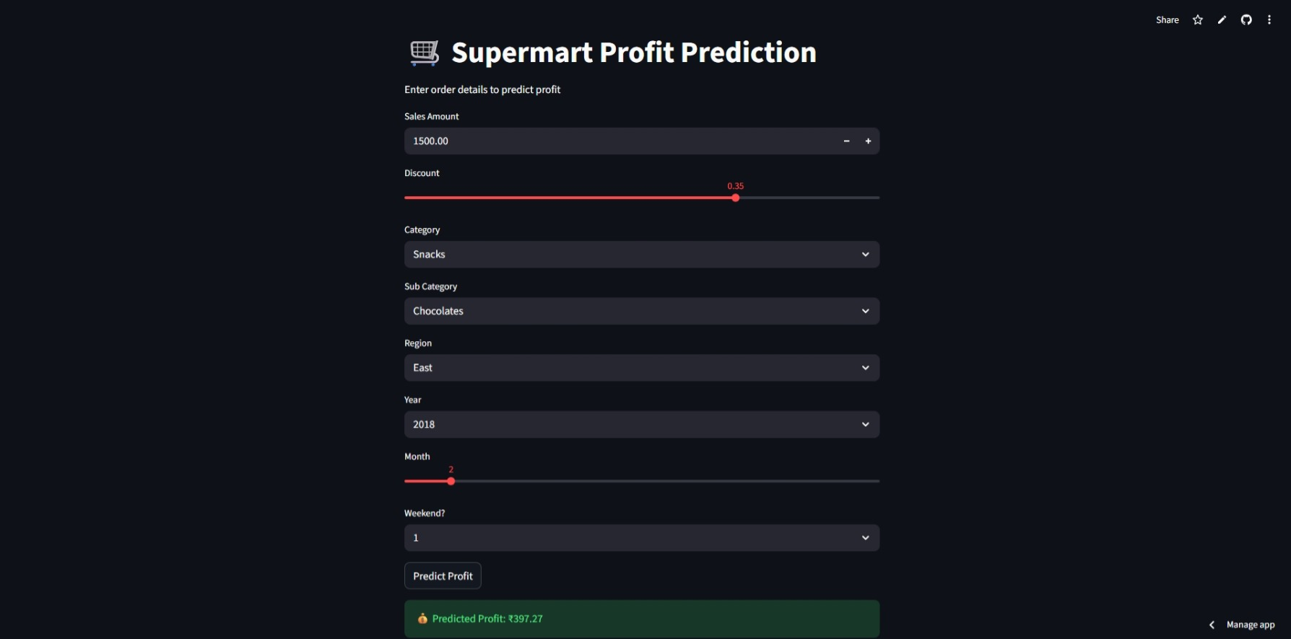
Streamlit Model Deployed

Slide 16
Business Solution
The developed profit prediction system enables retail teams to estimate expected profit before executing pricing and discount strategies. By providing scenario-based insights through an interactive dashboard, the solution helps businesses optimize discounts, improve category-level decision-making, and reduce the risk of profit loss. This data-driven approach supports smarter pricing, better promotion planning, and improved overall profitability.

Slide 17
Business Impact & Insights
High discounts negatively impact profitability
Certain categories consistently perform better
Profit prediction supports pricing and promotion decisions
Scenario testing reduces financial risk

Slide 18
Final Conclusion
This project demonstrates a complete retail analytics solution by combining Excel, SQL, Python, Machine Learning, and Streamlit deployment. Excel and SQL were used for initial data validation and business-level analysis, while Python enabled advanced analytics and modeling. The final deployed application allows stakeholders to predict profit in real time and make informed business decisions. This project reflects real-world data science workflows and highlights the importance of combining technical skills with business understanding.

Slide 19
Thank You
For Your Precious Time

